Slide 1


HR Attrition
Project Submitted by:
Arati Chavan

Slide 2
Table of contents
Sr. No | Particular
1 | Introduction
2 | Problem statement
3 | Analyzing Business Problem with data
4 | Insight on the Data Set
5 | Data Visualization
6 | Data Cleaning/ Data Pre-processing
7 | Models building
8 | Comparison of Models
9 | Interpretation of Models

Slide 3

HR Analytics
1) Introduction:
This project gives an overview of the attrition analysis
for a consulting firm and allows us to understand and
identify factors that help in retaining employees.
Employee Attrition has the following impacts on the organization:
1) Employee Attrition refers to the loss of employees through several circumstances, such as resignation.
2) Due to the expenses associated with training new employees, any type of employee attrition is typically seen to have a monetary cost.

Slide 4
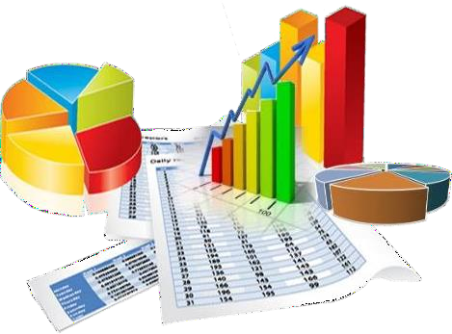
2) Problem Statement:
In the above backdrop, it may be stated that the employee attrition can cause company a lot.
This can also lead to loss of business, whereas the ultimate goal is to find out the main factors that cause influencing attrition of the employee and work on them to reduce it.

Slide 5
2) Problem Statement:
a) Objective of the employee attrition:
1) Identify factors influencing attrition.
2) Predict possible attritions.
3) Identify possible ways to retain high performers.

Slide 6

3) Steps for DATA Analysis:
The steps for DATA Analysis are followed,
a) Data understanding process, i.e read data and find Dependent and Independent factors or variables.
b) Data cleaning process, i.e removing anomalies or ‘noise’ from the given data.
c) Data Analysis using Algorithms (Python).
d) Data Interpretation is to explain the results

Slide 7

4) insight on the data set:
WE are using 2 data sets staff_16-17 and staff_17-18 .
Staff _16-17 we are using as train data.
Staff_17-18 we are using as Test data.
Train dataset - There are total 10 columns and 789 rows present in the data set
Test dataset - There are total 10 columns and 974 rows present in the data set
In the train/test datasets, the dependent variable is “Current Status” to predict.
After the data preprocessing and feature selection, we are left with –
1 Categorical-Ordinal feature – ‘Employee Position’
8 Numeric features , further undergone StandardScaler
Hence we will be working with 9 independent variables to predict a binary dependent variable

Slide 8
4) insight on the data set:
Insight on the Data Set - The data set contains two types of columns numeric variables and categorical variables.
a) Continuous variables-Continuous variables are numeric variables that have an infinite number of values between any two values.
Column name which contain Continuous data - Employee No, Total Hours, Total Available Hours, Total Work Hours ,Total Leave Hours ,Total Training Hours ,Total BD Hours ,Total NC Hours, Utilization% .
b) Categorical variables-Categorical variables contain a finite number of categories or distinct groups.
Column name which contain Categorical data - Profit Center, Employee Name, Employee Position, Employee Location ,People Group, Employee Category, Supervisor name, Current Status.
c) Date Format - Join Date and Termination Date.

Slide 9

5) Data Visualization :

Slide 10
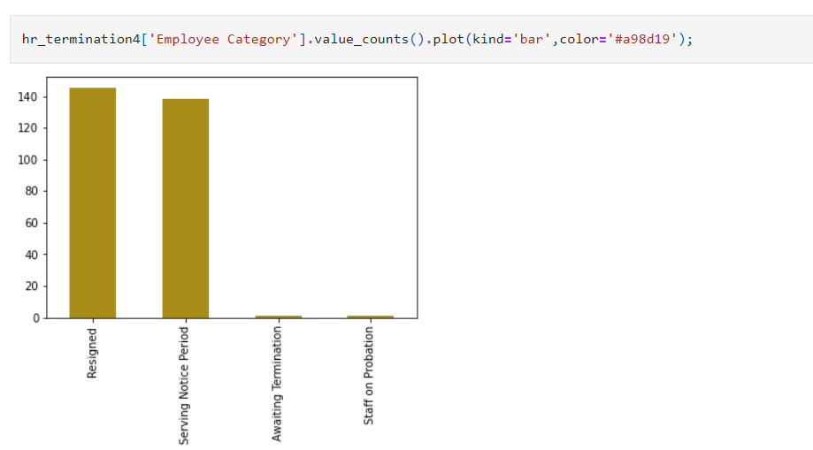
5) Data Visualization :
a) Distribution of ‘Employee Category’ shown below:____________

Slide 11
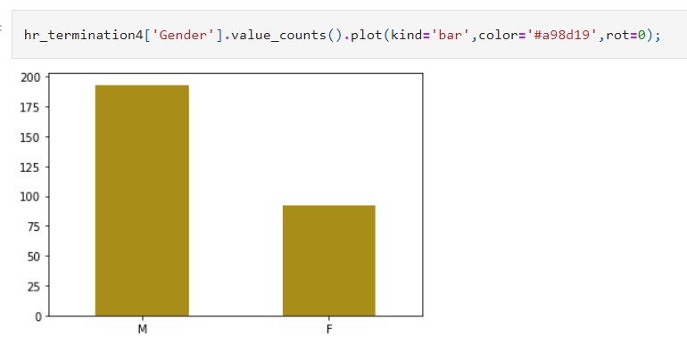
5) Data Visualization :
b) Distribution of Male and Female according to ‘Current status’ shown below:________

Slide 12
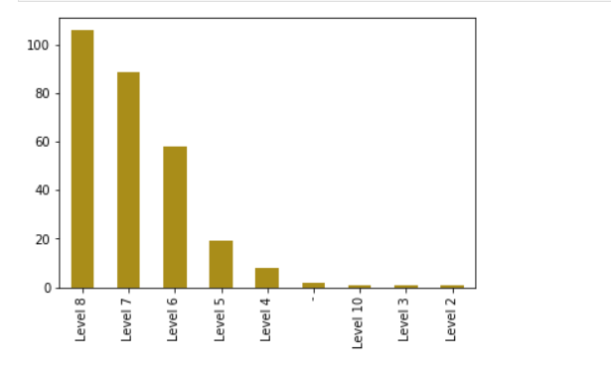
5) Data Visualization :
c) Distribution of Level according to ‘Employee Position’ shown below:__________

Slide 13
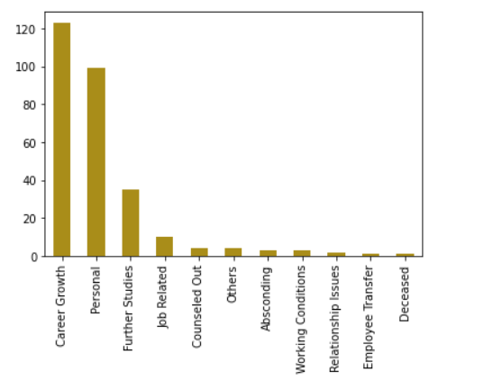
5) Data Visualization :
d) Distribution of ‘Leaving Reason’ shown below: _____________

Slide 14
6) Data cleaning / data Pre- processing :
Data cleansing or data cleaning is the process of detecting and correcting (or removing) corrupt or inaccurate records from a record set, table, or database. It refers to identifying incomplete, incorrect, inaccurate or irrelevant parts of the data and then replacing or modifying the data.
Data pre-processing is a process of preparing the raw data and making it suitable for a machine learning model.

Slide 15
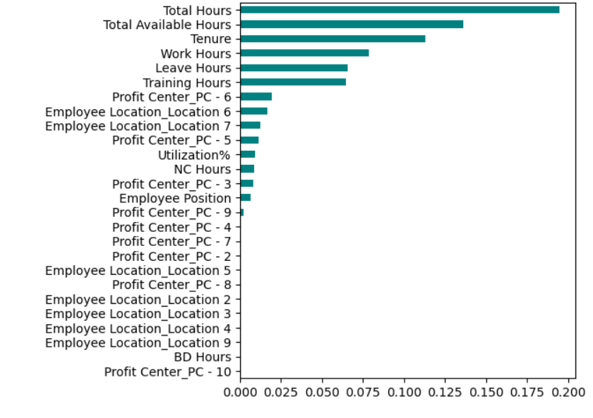
6) Data cleaning / data Pre- processing :
a) Feature Importance

Slide 16
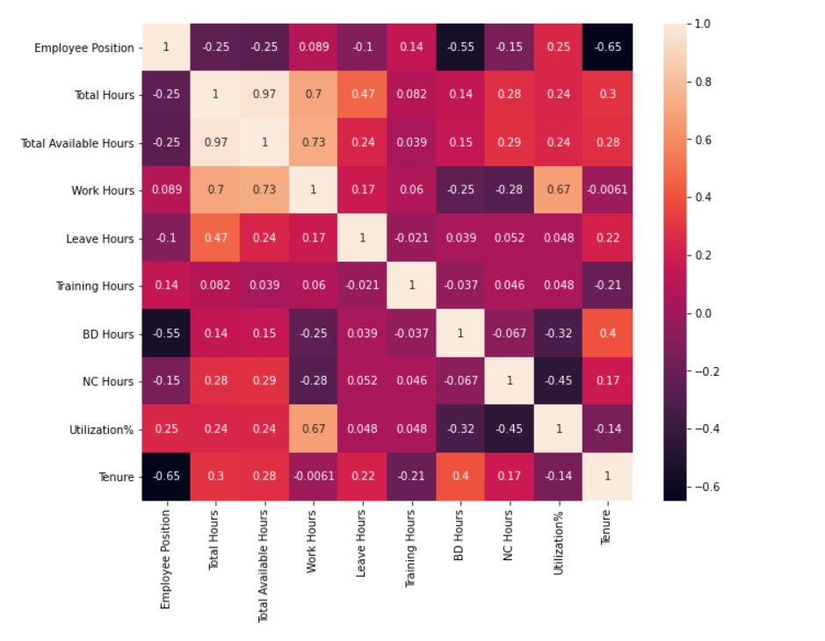
6) Data cleaning / data Pre- processing :
B) Feature Selection: Correlation between variables is established using correlation function and correlation matrix. Highly correlated variables are removed.

Slide 17
6) Data cleaning / data Pre- processing :
C) Dropping undesirable columns: Employee Name, Profit Center, Employee Location, People Group, Termination Date, Join Date, Employee Category, BD Hours are the columns that were deleted.
D) Handling Missing values: The next is to identify variables with Missing values. There is no missing value present in the dataset.
e) Dummy Variable: data variables which are nominal categorical types are encoded and assign 1 where class is Resigned and 0 where class is Active. The variables such as Current Status, Employee Position, Profit Center and Supervisor Name.

Slide 18
7) Model Building
After data cleaning and processing, it is ready for building different models for prediction. Model building is the process of developing a probabilistic model that best describes the relationship between the dependent and independent variables.
Three different models are being developed to predict the values. They are:
1) Logistic Regression
2) K-Nearest Neighbor (KNN)
3) Random Forest Model

Slide 19
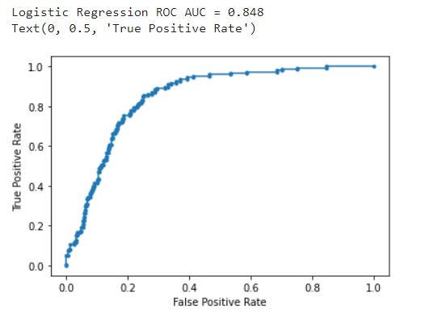
7) Model Building
1) Logistic Regression:
Logistic regression is a supervised learning classification algorithm used to predict the probability of a target variable. Generally, logistic regression means binary logistic regression having binary target variables, but there can be two more categories of target variables that can be predicted by it, named as Multinomial Logistic Regression.
Roc Curve: Roc curve shows the true positive rates against the false positive rate at various cut points. It also demonstrates a trade-off between sensitivity (recall and specificity or the true negative rate.

Slide 20
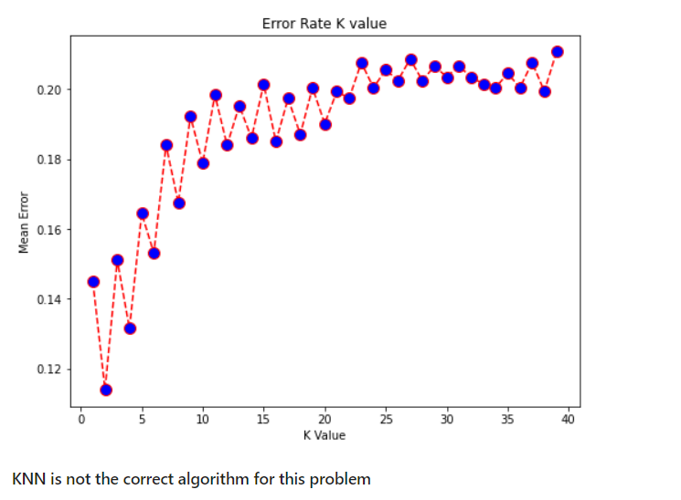
7) Model Building
2) K-Nearest Neighbor (KNN)
The k-nearest neighbors (KNN) algorithm is a simple, easy-to-implement supervised machine learning algorithm that can be used to solve both classification and regression problems. KNN is non-parametric algorithm.
However it is not a good choice for our problem

Slide 21
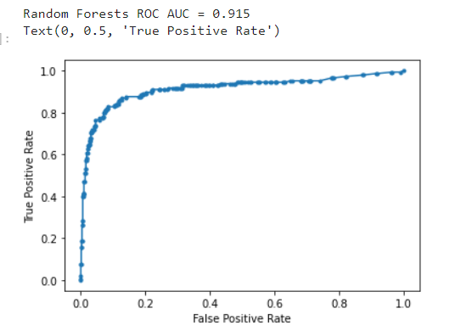
7) Model Building
3) Random Forest Model
Random forest is a tree-based algorithm which involves building several trees (decision trees), then combining their output to improve generalization ability of the model. The method of combining trees is known as an ensemble method.
Random forest looks a good choice for our problem

Slide 22
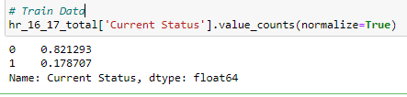
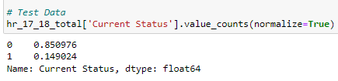
Handling Imbalanced Dataset
Technique to handle imbalanced dataset
The provided dataset is highly imbalanced with majority class is Current Status = ‘Active’
One approach to addressing imbalanced datasets is to oversample the minority class. This approach involves duplicating examples in the minority class, although these examples don’t add any new information to the model. Instead, new examples can be synthesized from the existing examples. It is referred to as the Synthetic Minority Oversampling Technique, or SMOTE for short.

Slide 23
8) Comparison of Models using the different performance measures obtained
Model | accuracy_score | precision_score | recall_score | f1_score | AUC
Logistic Regression | 0.69 | 0.42 | 0.81 | 0.56 | 0.85
Random Forest | 0.81 | 0.66 | 0.78 | 0.72 | 0.92

Slide 24
9) Interpretation of Models
From the above comparative table, it is observed that among all the models listed therein, Random Forest gives the best results i.e. accurate with 81% when it comes to prediction. Further, with the optimum parametric values the accuracy improves to 91%.
This implies that the Employee Attrition will be predicted 91% accurately using Random Forest with the optimum parametric values.

Slide 25
Thank u

